Slide 1


Web Scraping & Linear Regression
Dec 2021
Crypto Correlation
Prepared by: Li Sun

Slide 2


Introduction
Motivation
Lee’s investment Holdings is an investment management firm specializing in fundamental analysis of traditional financial assets (e.g. stocks, bonds, etc.).
They want to get in Crypto:
Problem: how do we conduct fundamental analysis on crypto when there is no fundamental valuation of cryptocurrency
Requests help to find crypto factors that are correlated with price and serves as a starting point to crypto fundamental analysis
Objective -
Goal: Find factors of crypto that is correlated with its price and use them to build a predictive model to identify undervalued crypto’s as investment opportunities
Notes:
Make it few words, more pictures

Slide 3
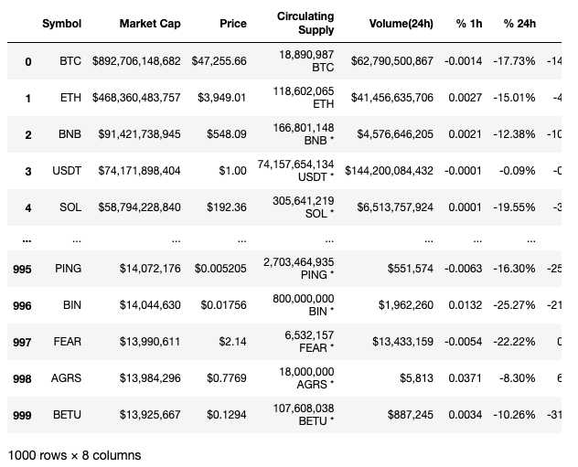
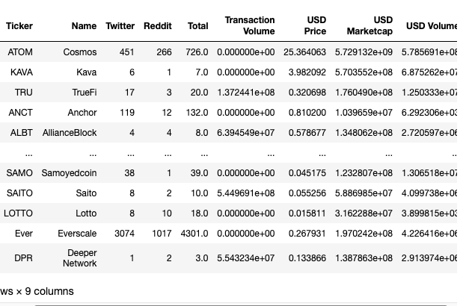
Methodology - Data
Dataset 1 – Circulating Supply Correlation
Data www.coinmarketcap.com
Close Price and 6 financial statistic numbers obtained for 1,000 cryptocurrencies
Dataset 2 – Social Media Correlation
Data is taken via API from https://santiment.net/
Close Price and 6 financial statistic numbers obtained for 715 cryptocurrencies (post cleaning)
Notes:
Need to zoom through this slide. Repeat ourselves less
Cut half the intro.
Use images

Slide 4






Methodology – Tools & Metrics
Tools –
Selenium for interactive website data scraping
BeautifulSoup for HTML parsing
Pandas and numpy for data manipulation
Matplotlib and Seaborn for data visualization
Sklearn and statsmodel for regression
GoogleSheets + API for downloading social media data
Metrics –
Pick the model with the highest R Squared value with least overfit
Notes:
Combine Slide 3 + 4, but visually

Slide 5
Methodology – Steps taken to Achieve Result
Step 1: Scrape Data from website
Step 2: Clean Data
Step 3: Create Baseline OLS linear regression model
Step 4: Check Assumption and Evaluation
Check for outliers using Cook D
Check for Non-normality (scatter and Q-Q plot)
Check for Collinearity (VIF)
Step 4: Residual Analysis - look for high residual observations for insight
Step 5: Apply Cross Validation
Train, validation, test
5-fold cross validation using K-Fold
Step 6: Apply Regularization
Ridge, Lasso, Elastic Net
Step 7: Apply Feature Engineering
Interaction Terms using Polynomial Features
Adding Dummy Variables
Step 8: Conclude and pick the best model
Step 9: Interpret Results
Notes:
Combine Slide 3 + 4, but visually

Slide 6
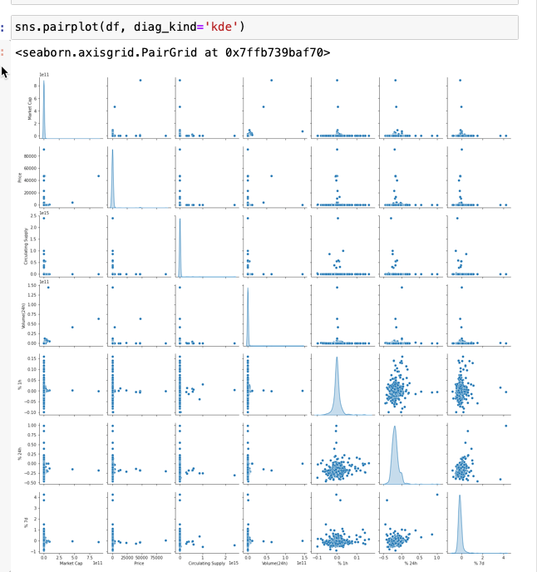
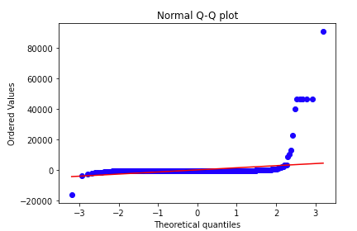
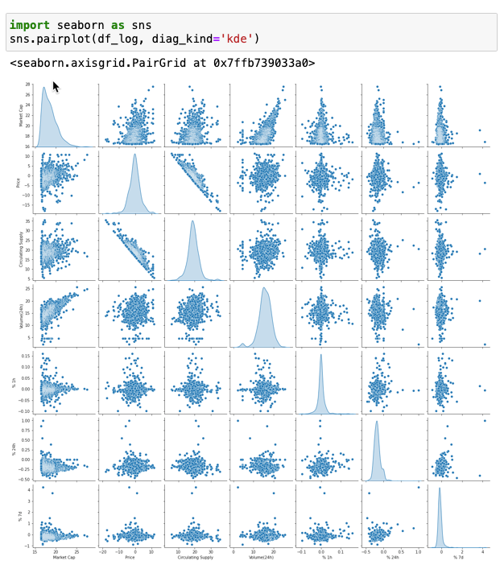
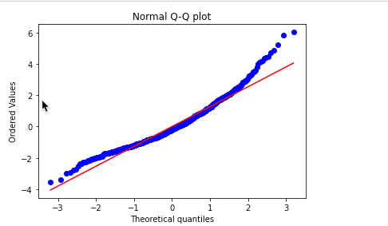



Dataset 1 Process – Taking Log on features and target made things clear
Decided to take the Log of Target (Price) + Circulating Supply + Volume due to Skewness + Non- Normality
R^2 increased from 0.079 to 0.868 after taking log on Price, Circulating Supply, and Price
Non-Normality
Right Skewed
Notes:
Foot Traffic / Competitor assumes that Foot Traffic is spread equally
What I’ll do next, is tackle this assumption.

Slide 7
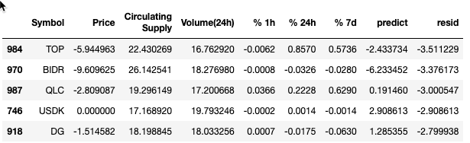
Dataset 1 (Circulating Supply) - Result
Linear Regression ran really well post logging the previously mentioned columns
Applied Cross Validation on Baseline Model
1st try – No overfit 0.868 R^2 on train, 0.866 on test (70-30) – No
2nd try – No overfit 0.865 R^2 on train, .850 on val, .895 on test (60-20-20)
K-Fold – 0.857 R^2 mean +- 0.014 std.
Applying Regularization: No Need to regularize as Baseline does not have overfitting
Feature Engineering: Applied Polynomial Features to boost R^2 up to 0.918, but slightly overfit
Conclusion – chose Baseline model as final model due to already High R^2 and no overfitting
Using Model to predict over and under valued crypto:
Biggest Residuals in ascending order mean that our Model predict price of TOP to be e^(-2.433) = 0.088 where actual prices are e^(-5.944) = 0.00262 <- Blueprint for Fundamental Analysis
Notes:
Foot Traffic / Competitor assumes that Foot Traffic is spread equally
What I’ll do next, is tackle this assumption.

Slide 8
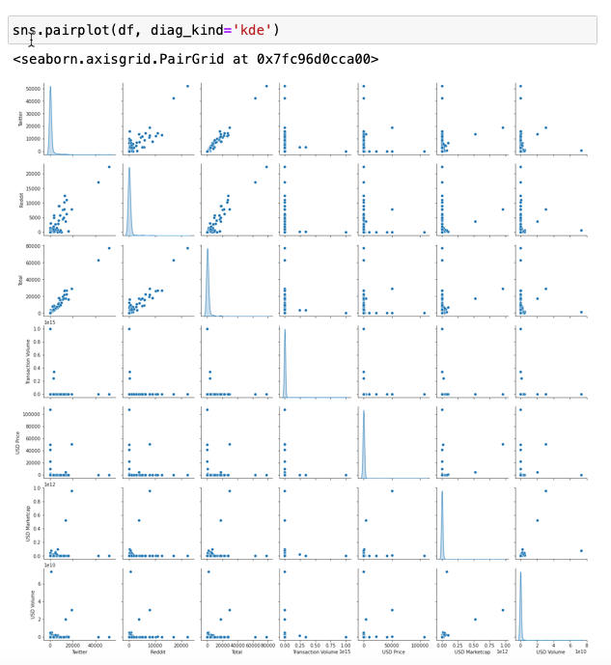
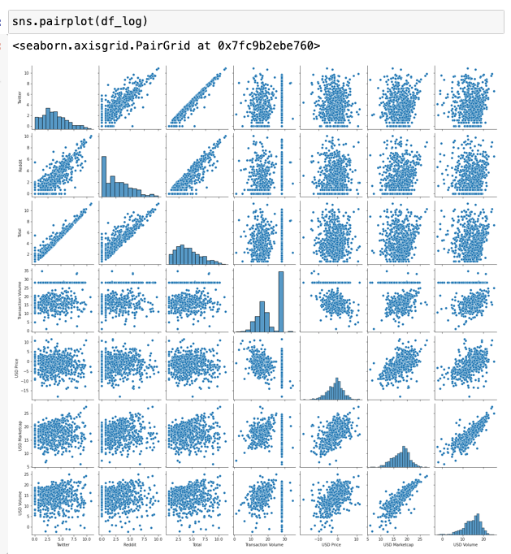






Dataset 2 Process – Taking Log on features and target made things clear
Same Process & Methodology as Dataset 1. Took Log to all features and Target due to Skewness
R^2 rose from 0.114 to 0.433 after taking log on all features and the target
Right
Skewed
Notes:
Foot Traffic / Competitor assumes that Foot Traffic is spread equally
What I’ll do next, is tackle this assumption.

Slide 9
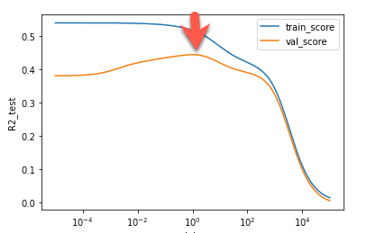
Dataset 2 - Result
Applied Cross Validation on Baseline Model
1st try – 0.433 R^2 on train, 0.423 on test (70-30)
2nd try – 0.404 R^2 on train, 0.462 on val, 0.466 on test (60-20-20)
K-Fold – 0.402 R^2 mean +- 0.035 std.
Applying Regularization:
Ridge – 0.419 on train, 0.472 on test, at alpha = 16.446
Lasso - 0.434 on train, 0.381 on test, at alpha = 0.1
ENet - 0.420 on train, 0.474 on test, at alpha = 0.01, L1_ratio =0.5
Feature Engineering:
Interaction Terms – improve model R^2 to 0.523 on train from 0.433
Baseline - 0.523 on train, 0.482 on test
Ridge – 0.509 on train, 0.516 on test, alpha at 1.05956
Lasso – 0.492 on train, 0.537 on test, alpha at 0.018465
Enet - 0.423 on train, 0.328 on test, alpha at 0.6, L1_ratio=0.01
Conclusion – chose Ridge model as final model due to highest R^2 with least overfit (Δ = 0.007)
Notes:
Foot Traffic / Competitor assumes that Foot Traffic is spread equally
What I’ll do next, is tackle this assumption.

Slide 10
Interpreting Coefficients - Insights
Dataset 1:
Circulating supply has a negative correlation coefficient of -0.956 with crypto price. Because both target and feature are log transformed, the explanation is that for every 10% increase in Circulating supply, the expected ratio of the crypto price will be (1.10)^(-0.956) = 0.9129. In other words, we expect about 8.7% decrease in crypto’s price when circulating supply increases by 10%.
Dataset 2:
Twitter has a positive correlation coefficient of 1.4567 with crypto price. Because both target and feature are log transformed, the explanation is that for every 10% increase in Twitter mention of crypto, the expected ratio of the crypto price will be (1.10)^(1.4567) = 1.1489. In other words, we expect about 14.9% increase crypto’s price when Twitter volume increases by 10%.
Total Social Media (Reddit + Twitter + Telegram) has a positive correlation coefficient of 2.0733 with crypto price. In same logic as above, we expect about 21.8% increase crypto’s price when Total Social Media Volume increases by 10%.
On-Chain Transaction Volume Squared has the highest positive correlation coefficient of 6.055 with crypto price. In same logic as above, we expect about 78% increase crypto’s price when Transaction^2 increases by 10%.
Notes:
Negatives were Twitter * Market Cap, Transaction volume * Trading Volume

Slide 11
Conclusion + Further Study
Conclusion:
Lee’s Investment holdings can use our baseline model to start discovering undervalued and overvalued crypto's.
On-chain transaction volumes + social media volumes are strongly correlated to price. Lee’s investment holdings should incorporate them to build fundamental analysis of crypto’s.

Slide 12
Appendix

Slide 13
Conclusion + Further Study
Conclusion:
Lee’s Investment holdings can use our baseline model to start discovering undervalued and overvalued crypto's.
On-chain transaction volumes + social media volumes are strongly correlated to price. Lee’s investment holdings should incorporate them to build fundamental analysis of crypto’s.
Further studies:
Gather additional data that could impact Crypto Prices
Time series model to predict Crypto Prices

Slide 14
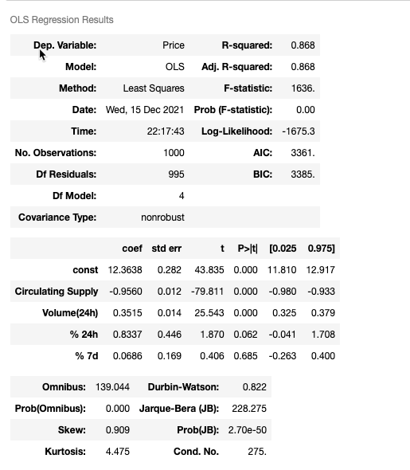
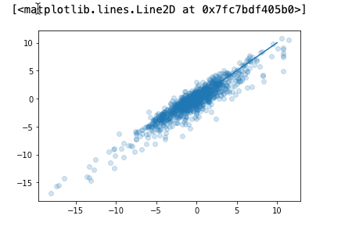
Appendix – Dataset 1
Notes:
An application program interface (API) is a piece of software code that allows two software programs to communicate with each other
APIs connect business processes, services, content and data to customers, staff and developers in an easy and secure way making it possible to easily connect differing sources of data
External APIs improve connectivity to the world, while internal APIs enable the enterprise to operate more efficiently
They are the digital glue in the digital value chain, powering mobile and web apps, connecting disparate systems, and enabling innovation

Slide 15
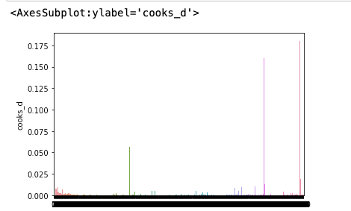
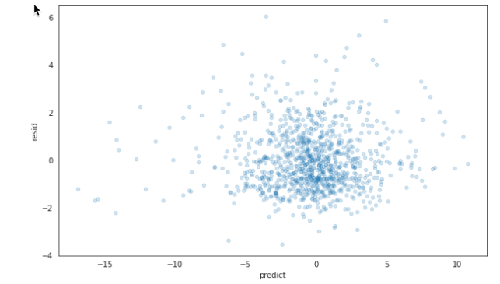
Appendix – Dataset 1 (continue)
Notes:
An application program interface (API) is a piece of software code that allows two software programs to communicate with each other
APIs connect business processes, services, content and data to customers, staff and developers in an easy and secure way making it possible to easily connect differing sources of data
External APIs improve connectivity to the world, while internal APIs enable the enterprise to operate more efficiently
They are the digital glue in the digital value chain, powering mobile and web apps, connecting disparate systems, and enabling innovation

Slide 16
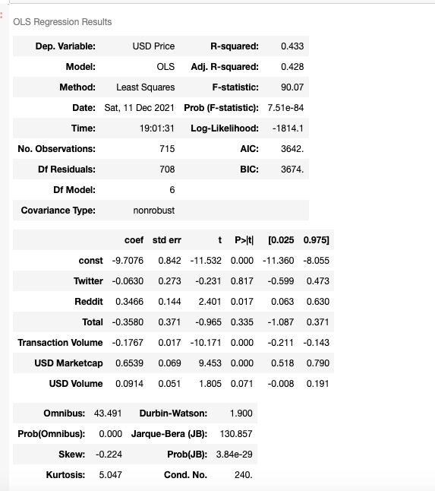
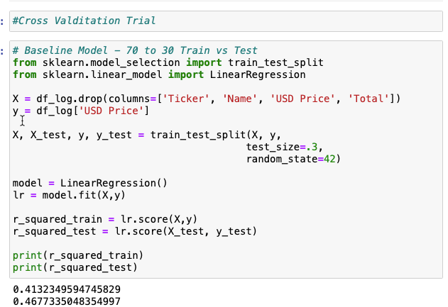
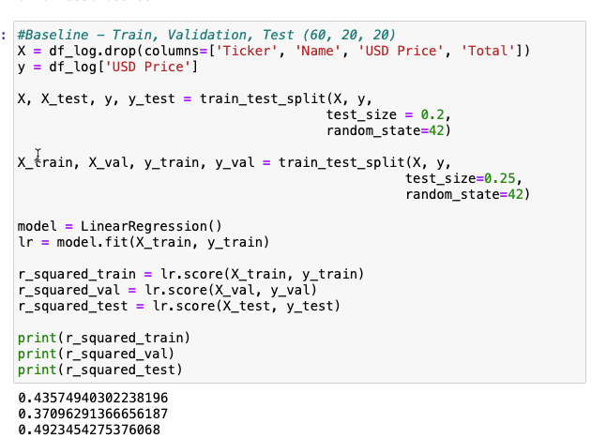
Appendix – Dataset 2 (Baseline)
Notes:
An application program interface (API) is a piece of software code that allows two software programs to communicate with each other
APIs connect business processes, services, content and data to customers, staff and developers in an easy and secure way making it possible to easily connect differing sources of data
External APIs improve connectivity to the world, while internal APIs enable the enterprise to operate more efficiently
They are the digital glue in the digital value chain, powering mobile and web apps, connecting disparate systems, and enabling innovation

Slide 17
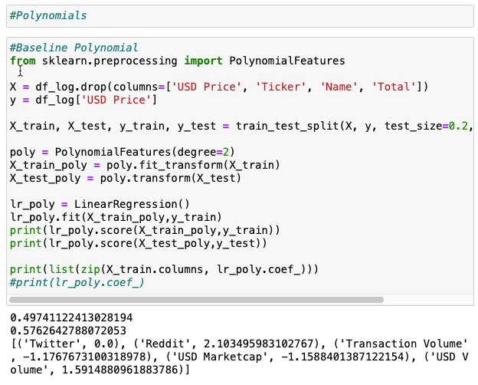
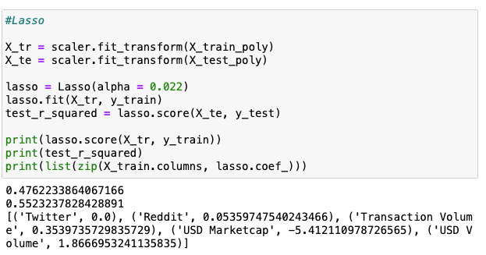
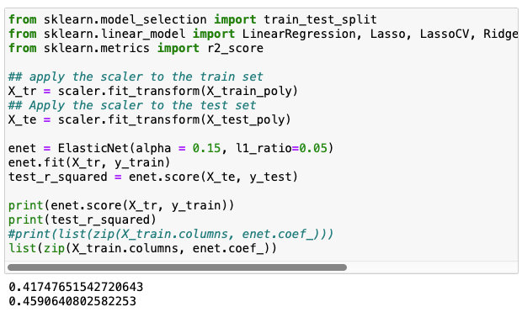
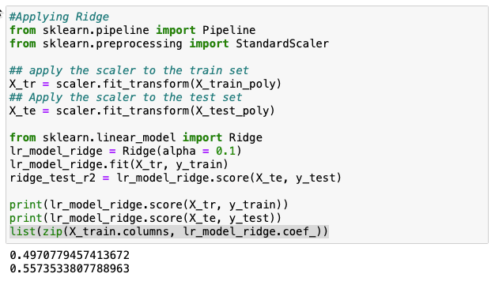
Appendix – Dataset 2 (Polynomial Features)
Notes:
An application program interface (API) is a piece of software code that allows two software programs to communicate with each other
APIs connect business processes, services, content and data to customers, staff and developers in an easy and secure way making it possible to easily connect differing sources of data
External APIs improve connectivity to the world, while internal APIs enable the enterprise to operate more efficiently
They are the digital glue in the digital value chain, powering mobile and web apps, connecting disparate systems, and enabling innovation

Slide 18
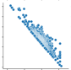
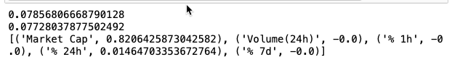
Dataset 1 - Result
Price to Circulating Supply looks to be almost too perfectly inverse correlated. Thus, I dropped this variable out of the model.
Linear Regression Assumptions held pretty well post logging
Applied Cross Validation on Baseline Model
1st try -Model is overfit 0.094 R^2 on train, 0.068 on test (70-30)
2nd try – Model is overfit 0.104 R^2 on train, 0.038 on val, 0.77 on test (60-20-20)
K-Fold – 0.065 R^2 mean +- 0.04 std.
Applying Regularization:
Ridge – still overfit, 0.0703 on train, 0.06553 on test, at alpha = 550
Lasso - no overfitting, collapsed 3 variables, 0.0785 on train, 0.0772 on test, at alpha = 0.2
ENet - overfit, manually tried, 0.0801 on train, 0.0771 on test, at alpha = 0.2, L1_ratio =0.8
Feature Engineering:
Adding Dummies - Did not improve R^2
Interaction Terms – improve model R^2 to 0.1066 on train, 0.0627 on test using Polynomial Features (Degree 2), but this caused model to be overfit
Applied Ridge, Enet, and Lasso –
Higher R^2 cause more overfitting (high discrepancy between train and test)
Optimal result with no overfitting is still Lasso with 0.0801 on train, 0.0771 on test.
Conclusion – chose Lasso model as final model due to it’s decent R^2 and no overfitting
Insight - Market cap has a positive relationship with Price. For every dollar increase in Market Cap, the crypto price will increase by e^(0.8206) times = 2.271 times
Notes:
Foot Traffic / Competitor assumes that Foot Traffic is spread equally
What I’ll do next, is tackle this assumption.

